Slide 1

Reinforcement learning and ML for cryptocurrencies
A basic model adapted from stock market: Predicting profitable moves

Slide 2

Declared dead more than 100 times
Simple API and 'low' transaction fees
Allows operation in fractions of the asset face value*
Algorithm adapts from stock market**
bitcoin
* Interactive Brokers now does that too.
** Curves and principle are the same but the business not.
Notes:
At Binance.com, the transaction fee is currently 0.075% for both the maker and the taker.
Interactive Brokers has a minimum 1 dollar value fee per transaction. However, the transaction fee will never be smaller than 1.00 nor bigger than 0.5%
You may able to buy as low as $1 in bitcoins.

Slide 3
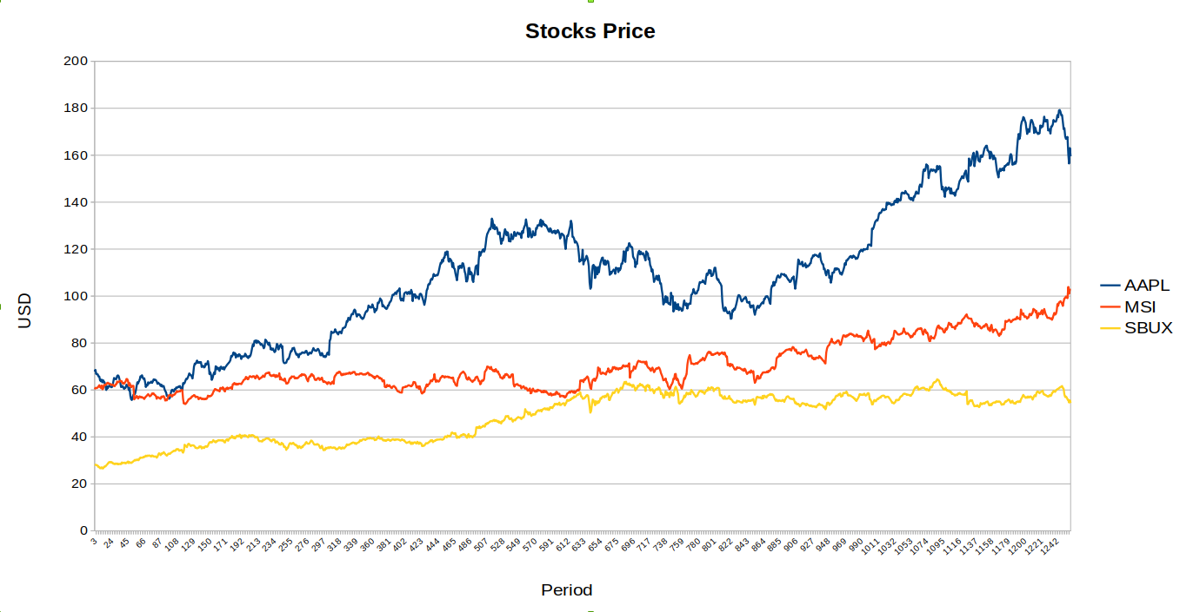
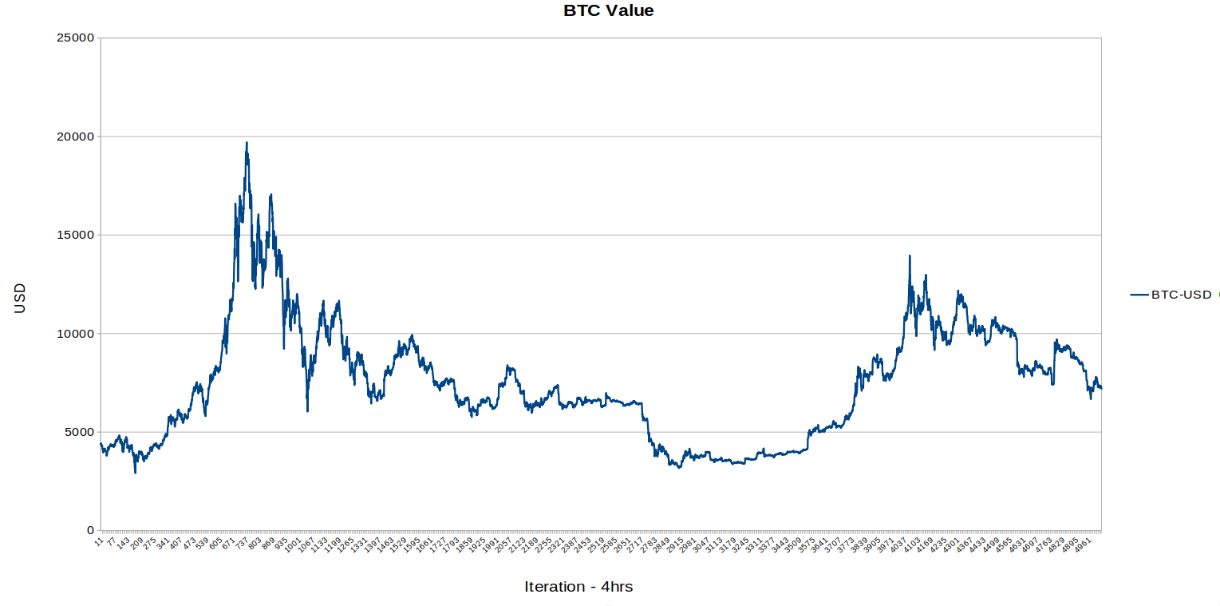
PRICES:
STOCKS X BITCOIN
Notes:
Different profiles. A random strategy may profit in the stock market where the measured assets usually grow
The bitcoin price for the same period has a different shape. Not really bearish, but thougher than the stock market

Slide 4
Project milestones
Connect API
Prepare
Papers and code
Apply
Adapt
Test existing codes
Adapt to Bitcoin
Compare performance
Validate Returns
Notes:
This assignment was handled as a project

Slide 5
PREPARE
Papers and code
Meta-analysis
Reinforcement learning in financial markets – A survey
https://www.econstor.eu/bitstream/10419/183139/1/1032172355.pdf
Selected material
Capturing Financial markets to apply Deep Reinforcement Learning
FMDP
Practical Deep Reinforcement Learning Approach for Stock Trading
DDPG
Chosen and adapted material
Practical Deep Reinforcement Learning Approach for Stock Trading
Notes:
Reference paper was not encouraging or motivating.
On the other hand, the existing materials allowed to practice different aspects of the current and previous courses.

Slide 6
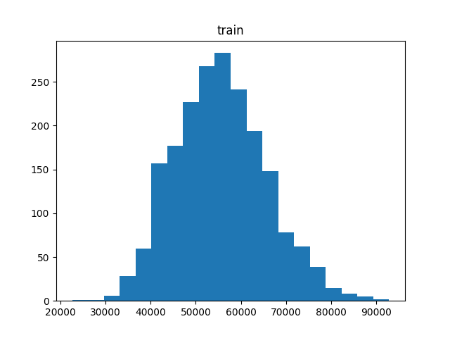
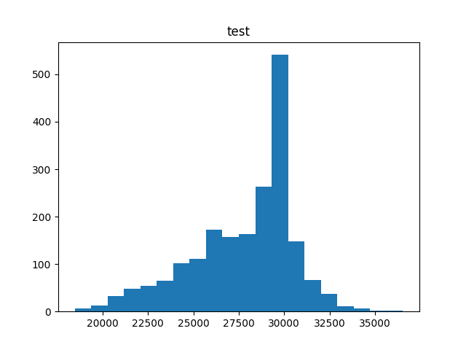
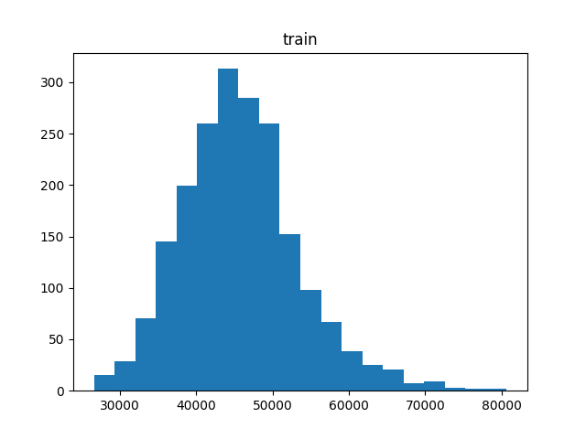
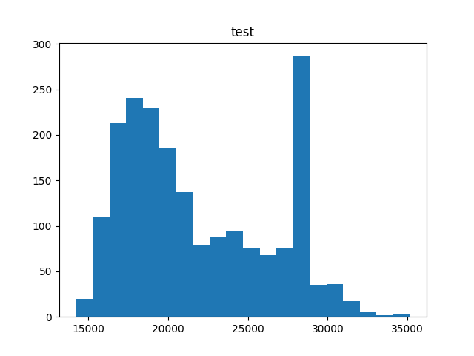
Original performance
Start = USD 20000; Gama = 0.95; Epsilon=0.95
Start = USD 20000; Gama = 0.95; Epsilon=0.6

Slide 7
adapt
Implementation
Converted to use BTC/USD
"End of day" concept reduced for every 4 hours
Hyperparameters exploration
Simplifications
No candles, no volume
Linear regression: square error
Only one asset,"EOD" every 4 hours
Buy all / Sell all strategy

Slide 8
adapt
General idea
env = MyTradingEnv()
done = False # Is the episode over?
state = env.reset() #Initial state
while not done:
action = get_action(state) # From agend instead of action
# Perform the trade, update 'statement' (the portifolio value)
next_state, reward, done, statement = env.step(action)
State = next_state
Function of portfolio value – gain / lost (numeric, real)
Change in value of owned portfolio from one state to the next s'
s: vector of # shares owned
p: vector of share prices
c: cash
Portfolio value = s^T.p + c
(the transposed matrix of s times p plus c)
Notes:
Will sound familiar to https://gym.openai.com/docs/

Slide 9
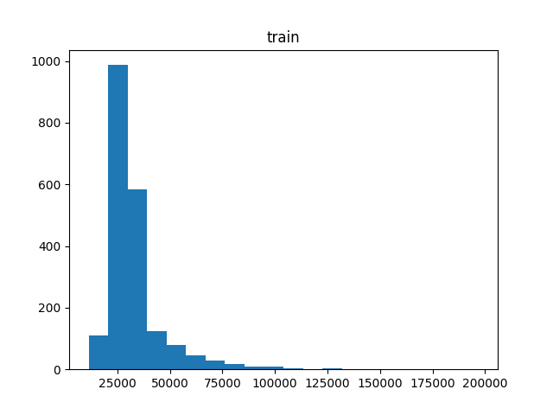
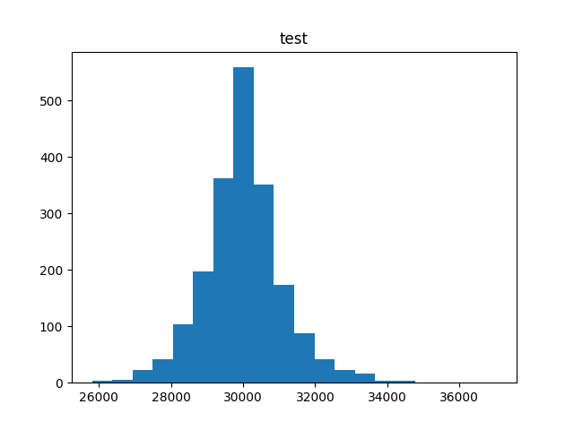
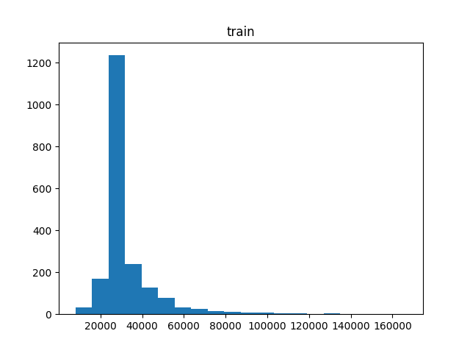
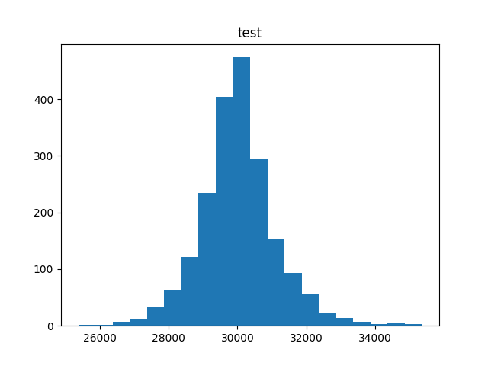
Adapted1
Start = USD 30000; Gama = 0.95; Epsilon=0.95
Start = USD 30000; Gama = 0.95; Epsilon=0.6

Slide 10
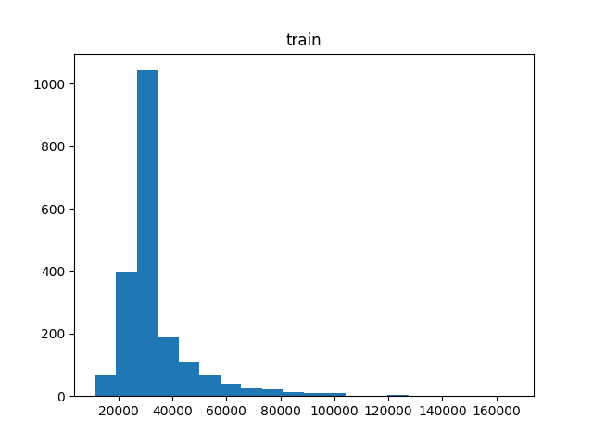
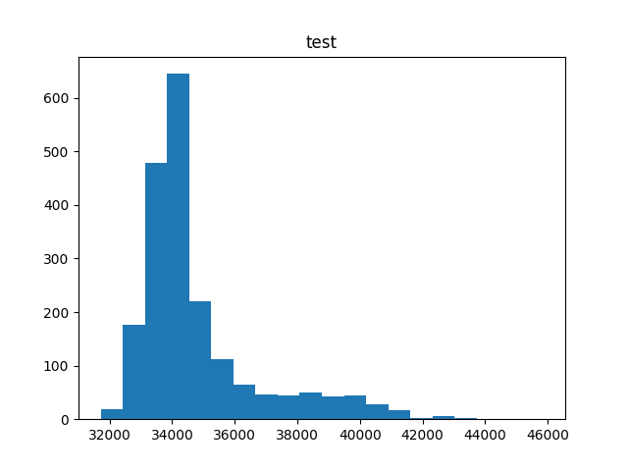
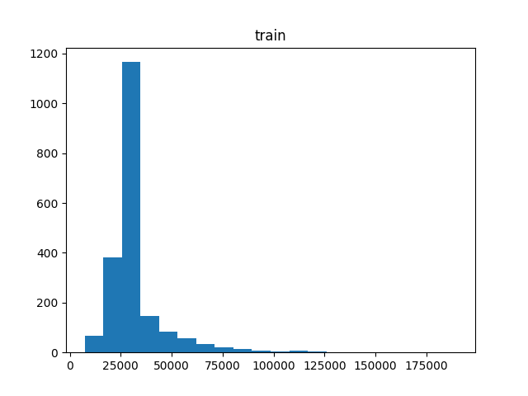
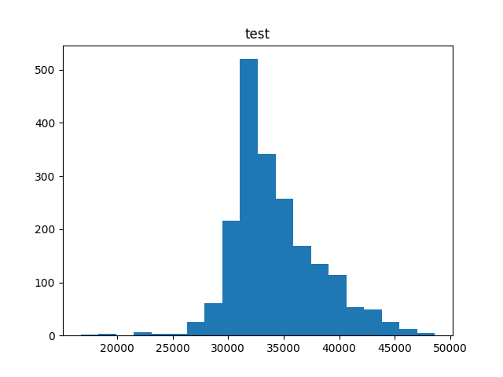
Adapted II
Safer: Start = USD 30000; Gama = 0.75; Epsilon=0.95
Aggressive: Start = USD 30000; Gama = 0.75; Epsilon=0.6

Slide 11
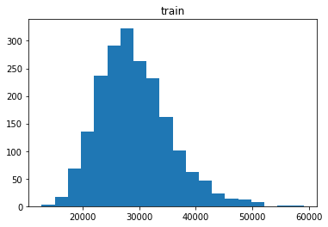
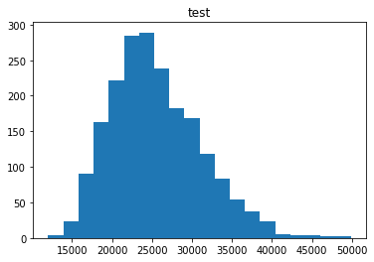
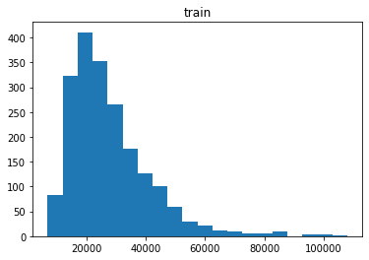
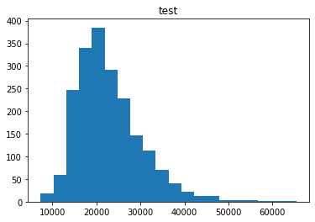
random
STOCKS - Start = USD 20000; Gama = 0.95; Epsilon=0.95
BTC - Start = USD 20000; Gama = 0.95; Epsilon=0.6

Slide 12
Next Steps
Why not act on BTC/USD?
Binance API
Start with BTC 0.001
"End of day" concept reduced for every 4 hours
Differences or previous state
Maybe dollar-level operation on Interactive Broker
Cherry pick asset or group of assets
"Keep it simple": 1 asset, more features
Connect to the broker Metatrader
Notes:
The agent has no idea of the concept of change of state or previous state unless we implement it.

Slide 13

Thank you
https://github.com/humbertosouza
humbertosouza@outlook.com

